Slide 1






Project 2: Serverless Image Processing
with S3 and Lambda
AWS Solutions Architect - Associate
Event-Driven Serverless Architecture
Serverless
Event-Driven
Image Processing
Cost Efficient
Khalid Mohamed Salman

Slide 2













Project Overview
Project Goals
Architecture Type
Build event-driven serverless application
Implement automatic image processing
Configure S3 event triggers
Optimize for cost and performance
Serverless
Event-driven, auto-scaling, pay-per-use computing
Learning Outcomes
Serverless architecture patterns
Key Technologies
Lambda function development
S3 event-driven processing
S3
Lambda
API Gateway
DynamoDB

Slide 3


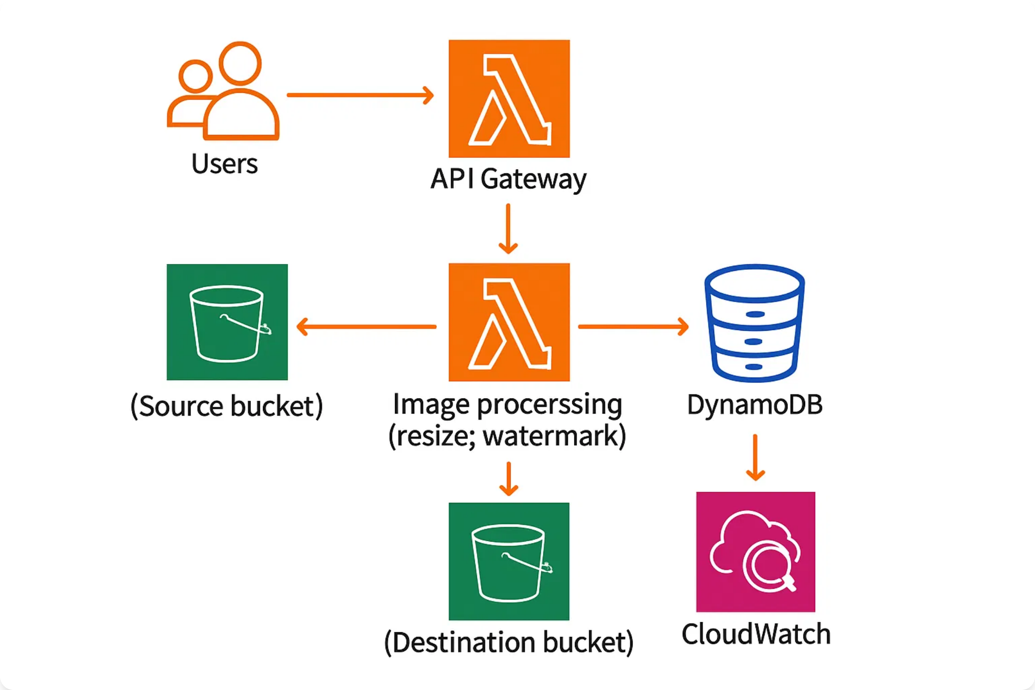



Serverless Architecture Diagram
Event-Driven Image Processing
Serverless, scalable, and cost-effective architecture
Users
API Gateway
S3 Buckets
Lambda
Upload images
Upload endpoint
Storage & triggers
Image processing

Slide 4









Key AWS Services
Amazon S3
AWS Lambda
Simple Storage Service
Serverless Compute
Object storage for images
Event-driven execution
Event notifications and triggers
Automatic scaling
Virtually unlimited scalability
Pay-per-request pricing
API Gateway
DynamoDB
RESTful API Management
NoSQL Database
HTTP endpoints for uploads
Image metadata storage
Request/response transformation
Serverless and managed
Built-in security features
Single-digit millisecond latency
IAM for Security
CloudWatch Monitoring
Step Functions (Optional)

Slide 5







Implementation Phases
1
Environment Setup
2
S3 Buckets Creation
Create AWS account and IAM user
Create source bucket for uploads
Choose AWS region
Create destination bucket for processed images
Set up permissions
Configure security and encryption
3
IAM Role & Lambda
4
S3 Event Triggers
Create Lambda execution role
Configure S3 event notifications
Develop image processing function
Set up Lambda triggers
Add PIL/Pillow library
Test event-driven processing
5
API Gateway (Optional)
6
Monitoring & Cleanup
Create REST API
Set up CloudWatch monitoring
Configure upload endpoints
Performance optimization
Deploy and test API
Clean up resources

Slide 6






S3 and Lambda Setup
S3 Bucket Configuration
Lambda Function Code
Source: my-image-upload-bucket
# Import required libraries
Destination: my-processed-images-bucket
import json, boto3
from PIL import Image
Enable versioning and encryption
import io, os
Block public access (security)
# Initialize S3 client
s3_client = boto3.client('s3')
# Lambda handler function
def lambda_handler(event, context):
IAM Role Permissions
# Get S3 event details
bucket = event['Records'][0]['s3']['bucket']['name']
AWSLambdaBasicExecutionRole
key = event['Records'][0]['s3']['object']['key']
S3 GetObject permissions
# Process and resize image
# Upload to destination bucket
S3 PutObject permissions
CloudWatch Logs access
Lambda Configuration
Runtime & Memory:
• Runtime: Python 3.9
• Memory: 512 MB
• Timeout: 30 seconds
Environment Variables:
• DESTINATION_BUCKET
• Add PIL layer for image processing

Slide 7










Event-Driven Processing
S3 Event Notifications
Image Processing Features
Event Configuration:
Automatic image resizing
• Event name: image-upload-trigger
Format conversion (JPEG/PNG)
• Event types: s3:ObjectCreated:*
Quality optimization
• Suffix filter: .jpg, .jpeg, .png
• Destination: Lambda function
Watermarking (optional)
Thumbnail generation
Trigger Benefits:
• Real-time processing
• No polling required
• Automatic scaling
Performance Considerations
Lambda memory allocation
Timeout configuration
Processing Workflow
Concurrent execution limits
Error handling and retries
1
Image uploaded to S3
2
S3 triggers Lambda function
3
Lambda processes image
4
Processed image saved to S3
Event-Driven Architecture Benefits
Real-time Processing
Auto Scaling
Cost Efficient
Serverless

Slide 8








API Gateway and DynamoDB Integration
API Gateway Setup
Enhanced Lambda Function
REST API Configuration:
Store metadata in DynamoDB
• API name: image-upload-api
Generate unique image IDs
• Resource: /upload
Track processing timestamps
• Method: POST
• Integration: AWS Service (S3)
Error handling and logging
Return processing status
Deployment:
• Stage: prod
• CORS enabled
• Authentication (optional)
Optional Enhancements
Step Functions for complex workflows
SNS notifications for completion
DynamoDB Table Design
SQS for batch processing
CloudFront for image delivery
Table: image-metadata
• Partition Key: image_id (String)
• Attributes: original_key, processed_key
• Timestamps: upload_time, process_time
• Image dimensions and file sizes
Complete Serverless Stack
API Gateway
S3
Lambda
DynamoDB

Slide 9








Monitoring and Optimization
CloudWatch Metrics
Performance Optimization
Lambda Metrics:
Optimize Lambda memory allocation
• Invocations and duration
Use Lambda layers for dependencies
• Error rate and throttles
Implement connection pooling
• Memory utilization
• Cold start frequency
Optimize image processing algorithms
Configure provisioned concurrency
S3 Metrics:
• Request metrics
• Storage utilization
• Data transfer costs
Debugging and Logging
CloudWatch Logs analysis
X-Ray tracing for performance
Alarms and Notifications
Error handling and retries
Lambda error rate > 5%
Dead letter queues for failures
Function duration > 25 seconds
Throttle events detected
DynamoDB throttling
Serverless Monitoring Best Practices
Real-time Metrics
Distributed Tracing
Cost Monitoring
Error Tracking

Slide 10









Serverless Best Practices
Security Best Practices
Resource Cleanup Order
Use IAM roles with least privilege
1
Delete Lambda function
Enable S3 bucket encryption
Implement API Gateway authentication
2
Empty and delete S3 buckets
Use VPC for sensitive workloads
Enable CloudTrail for auditing
3
Delete DynamoDB table
4
Delete API Gateway
Cost Optimization
5
Delete IAM roles and policies
Right-size Lambda memory allocation
Use S3 Intelligent Tiering
6
Delete CloudWatch logs
Monitor and optimize function duration
Implement lifecycle policies
Set up billing alerts
Project Deliverables
Serverless architecture diagram
GitHub repository with Lambda code
Deployment instructions
Working demo or video (optional)
Excellent Work!
You've built a scalable, event-driven serverless image processing application
Serverless
Event-Driven
Auto-Scaling
Cost-Efficient

